Slide 1
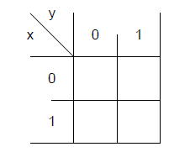
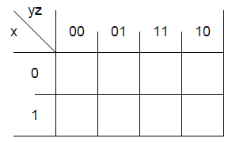
K-Map
K- map is graphical representation of truth table.
Each cell of K-Map corresponds to one minterm of function.
Adjacent cells differ by one literal i.e x or x’.
Used to simplify the 2,3,4 and 5 variables expressions.

Slide 2
Simplification Using K- Map
  Steps:
    From expression, draw the required no. of boxes
    Expression should be in “Sum of Product/Minterms form
    (If not already) Express function in sum of minterms
    Input the function → K-map (insert ‘1’ as appropriate)
    Group adjacent squares containing ‘1’ (2,4,8,…)
    Write same/common variables (or their compliments)
    Simply add them

Slide 3
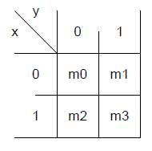
K-Map with 2 Variables
One cell represents a term with two literals
A group of two adjacent cells represent a term with one literal.
A group of four adjacent cells produce a function which is always ‘1’ .
y
x
0
1
x’y’
x’y
0
x
1
xy’
xy

Slide 4






Two-Variable K - Map
Example
 | y
x |  | 0 | 1
 | 0
 | 1
m₀ | m₁
m₂ | m₃
Y
 |  |  | y
 |  | 0 | 1
x |  | 1 | 1
X

Slide 5











Three-Variable K - Map
 | x y z | Minterm
0 | 0 0 0 | m₀
1 | 0 0 1 | m₁
2 | 0 1 0 | m₂
3 | 0 1 1 | m₃
4 | 1 0 0 | m₄
5 | 1 0 1 | m₅
6 | 1 1 0 | m₆
7 | 1 1 1 | m₇
m₀ | m₁ | m₃ | m₂
m₄ | m₅ | m₇ | m₆
 | y z
x |  | 00 | 01 | 11 | 10
 | 0
 | 1

Slide 6



Three-Variable K - Map
Example
 | y z
x |  | 00 | 01 | 11 | 10
 | 0
 | 1
1
One square represents one minterm, giving a term with three literals
 | y z
x |  | 00 | 01 | 11 | 10
 | 0
 | 1
1
1
Two adjacent squares represent a term with two literals

Slide 7


Three-Variable K - Map
Example
 | y z
x |  | 00 | 01 | 11 | 10
 | 0
 | 1
1
1
1
1
Four adjacent squares represent a term with one literal
 | y z
x |  | 00 | 01 | 11 | 10
 | 0
 | 1
1
1
1
1
1
1
1
1
Eight adjacent squares encompass the entire map and always produces F = 1

Slide 8
Slightly Modifying Def. of Adjacent Squares
    We know that minterm of each square differs from that of its neighboring’s minterm by 1 bit (Gray code)
    Does this apply on Squares at the extreme edges?
    e.g. see m₂ and m₀
    See m₆ and m₄
    Imagine map being drawn on a surface in which right and left edges touch each other (adjacent squares)
 | y z
x |  | 00 | 01 | 11 | 10
 | 0
 | 1
 | y z
x |  | 00 | 01 | 11 | 10
 | 0
 | 1
m₀ | m₁ | m₃ | m₂
m₄ | m₅ | m₇ | m₆
m₀ | m₁ | m₃ | m₂
m₄ | m₅ | m₇ | m₆

Slide 9
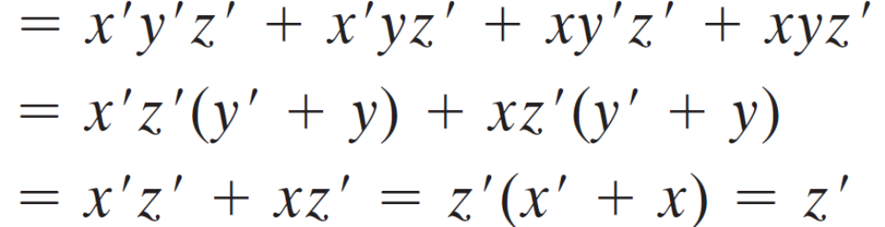
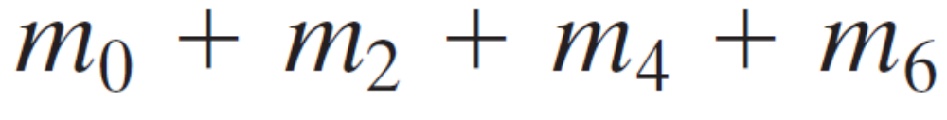

 | y z
x |  | 00 | 01 | 11 | 10
 | 0
 | 1
1
1
1
1

Slide 10



T hree-Variable K - Map
Example
m₀ | m₁ | m₃ | m₂
m₄ | m₅ | m₇ | m₆
 | x y z | Minterm |  | F
0 | 0 0 0 | m₀ |  | 0
1 | 0 0 1 | m₁ |  | 0
2 | 0 1 0 | m₂ |  | 1
3 | 0 1 1 | m₃ |  | 1
4 | 1 0 0 | m₄ |  | 1
5 | 1 0 1 | m₅ |  | 1
6 | 1 1 0 | m₆ |  | 0
7 | 1 1 1 | m₇ |  | 0
 | y z
x |  | 00 | 01 | 11 | 10
 | 0
 | 1
 |  |  |  | y
 |  | 0 | 0 | 1 | 1
x |  | 1 | 1 | 0 | 0
 |  |  | z

Slide 11

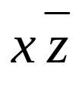


Three-Variable K - Map
Example
m₀ | m₁ | m₃ | m₂
m₄ | m₅ | m₇ | m₆
 | x y z | Minterm |  | F
0 | 0 0 0 | m₀ |  | 0
1 | 0 0 1 | m₁ |  | 0
2 | 0 1 0 | m₂ |  | 0
3 | 0 1 1 | m₃ |  | 1
4 | 1 0 0 | m₄ |  | 1
5 | 1 0 1 | m₅ |  | 0
6 | 1 1 0 | m₆ |  | 1
7 | 1 1 1 | m₇ |  | 1
 | y z
x |  | 00 | 01 | 11 | 10
 | 0
 | 1
 |  |  |  | y
 |  | 0 | 0 | 1 | 0
x |  | 1 | 0 | 1 | 1
 |  |  | z
Extra

Slide 12


T Three-Variable K - Map
Example
m₀ | m₁ | m₃ | m₂
m₄ | m₅ | m₇ | m₆
 | x y z | Minterm |  | F
0 | 0 0 0 | m₀ |  | 1
1 | 0 0 1 | m₁ |  | 0
2 | 0 1 0 | m₂ |  | 1
3 | 0 1 1 | m₃ |  | 0
4 | 1 0 0 | m₄ |  | 1
5 | 1 0 1 | m₅ |  | 1
6 | 1 1 0 | m₆ |  | 1
7 | 1 1 1 | m₇ |  | 0
 | y z
x |  | 00 | 01 | 11 | 10
 | 0
 | 1
 |  |  |  | y
 |  | 1 | 0 | 0 | 1
x |  | 1 | 1 | 0 | 1
 |  |  | z

Slide 13

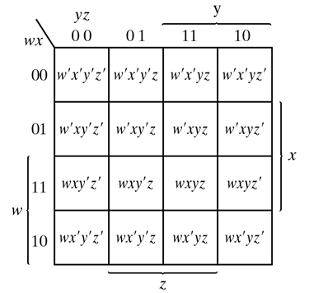
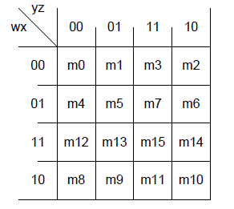
K-Map with 4 Variables

Slide 14
K-Map with 4 Variables
One cell represents a term with four literals
A group of two adjacent cells represent a term with three literals.
A group of four adjacent cells represent a term with two literals.
A group of eight adjacent cells represent a term with one literal.
A group of sixteen adjacent cells produce a function which is always ‘1’ .

Slide 15
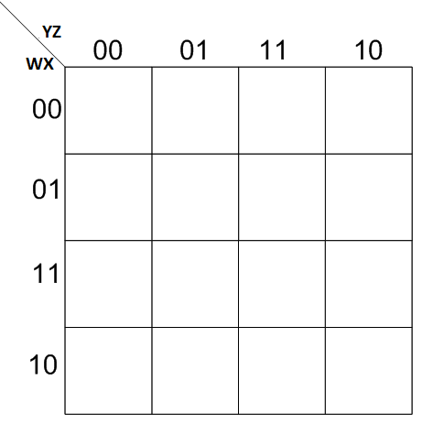
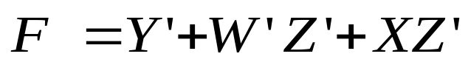
Example:
Y’
W’Z’
1
1
1
1
1
1
1
1
1
1
1
XZ’

Slide 16
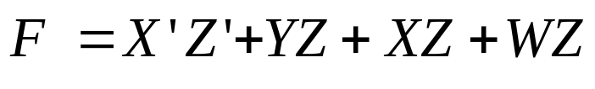
Advance k-map
The simplified expression of a function obtained from k-map is not unique . It is sometimes possible to find two or more expressions that satisfy the minimization criteria. In that case either solution is satisfactory.
X’Z’
YZ
X’Z’
YZ
1
1
1
1
1
1
XZ
1
1
XZ
1
1
WZ
1
1
1
1
WX’
1
1
1
1
1
1
1
1

Slide 17
Implicant and Prime Implicants
Implicant: a group of one more k-map cells.
Prime Implicant: an implicant that is not subset of another implicant.
Essential Prime Implicant: If minterm is part of only one prime implicant then that prime implicant is said to be essential prime implicant.

Slide 18
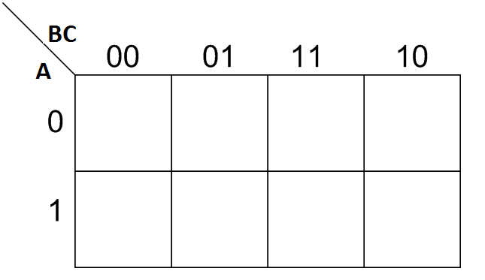
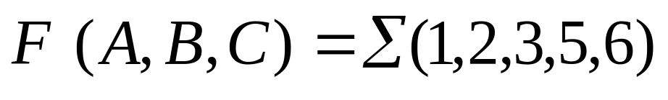
Three-Variable K-Map Example
Step 1: Plot the K-map
1
1
1
1
1
1

Slide 19
Three-Variable K-Map Example
Step 2: Circle ALL Prime Implicants
PI
PI
1
1
1
1
PI
1
1
PI

Slide 20
Three-Variable K-Map Example
Step 3: Identify Essential Prime Implicants
PI
PI
1
1
1
1
EPI
1
1
EPI

Slide 21
Three-Variable K-Map Example
Step 3: Identify Essential Prime Implicants
1
1
1
1
B’C
1
1
BC’

Slide 22
Three-Variable K-Map Example
Step 4: Select minimum subset of remaining
Prime Implicants to complete the cover.
A’C
First Simplified Expression
F= B’C+BC’+ A’C
1
1
1
1
1
B’C
1
BC’

Slide 23
Three-Variable K-Map Example
Step 4: Select minimum subset of remaining
Prime Implicants to complete the cover.
A’B
Second Simplified Expression
F= B’C+BC’+ A’B
1
1
1
1
1
B’C
1
BC’

Slide 24
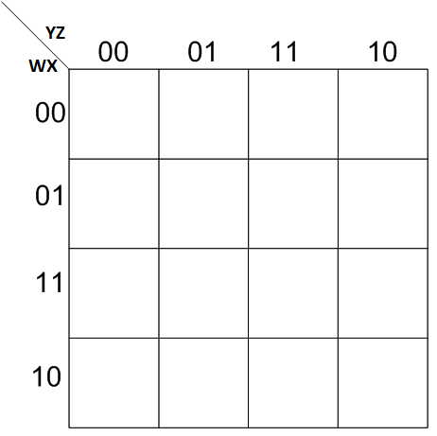
Four Variable K-Map Example
Determine all prime implicants and also find which of them are essential.
Determine all possible simplified expression of function.
1
1
1
1
1
1
1
1
1
1

Slide 25
Four Variable K-Map Example
Step 2: Circle ALL Prime Implicants
PI
PI
1
1
1
1
1
1
1
1
1
1
1
1
PI
1
1
1
1
PI
1
1
1
1

Slide 26
Four Variable K-Map Example
Step 3: Identify Essential Prime Implicants
EPI
PI
1
1
1
1
1
1
1
1
1
1
1
1
PI
1
1
1
1
EPI
1
1
1
1

Slide 27
Four Variable K-Map Example
Step 3: Identify Essential Prime Implicants
X’Z’
1
1
1
1
1
1
1
1
XZ
1
1

Slide 28
Four Variable K-Map Example
Step 4: Select minimum subset of remaining
Prime Implicants to complete the cover.
X’Z’
First Simplified Expression
1
1
F= XZ + X’Z’ + W’X
1
1
1
1
1
1
W’X
XZ
1
1

Slide 29
Four Variable K-Map Example
Step 4: Select minimum subset of remaining
Prime Implicants to complete the cover.
X’Z’
Second Simplified Expression
1
1
F= XZ + X’Z’ + W’Z’
1
1
1
1
1
1
W’Z’
XZ
1
1

Slide 30


Product of Sum Simplification
Let F be a function → F’ = (all minterms not in F)
F= (all minterms not in F)’
Therefore one can obtain Product of Sum (POS) by:
Group all 0’s on K-map.
Use the De-morgan theorem to obtain POS expression.

Slide 31

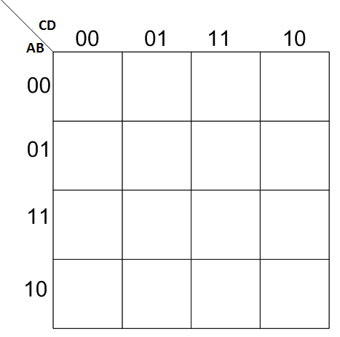
Example
Simplify the Boolean function into product of sum form.
CD
BD’
0
0
0
0
F’= AB + CD + BD’
AB
0
0
0
0
F=( AB)’ (CD )’(BD’)’
F=(A’+B’) (C’+D’) (B’+D)
0

Slide 32
Don’t Care Conditions:
Some time not all the values of function is defined.
Some input conditions will never occur.
We don’t care what the output for that input condition.
In these cases, we can choose the output to be either ‘0’ or ‘1’.
Don’t cares are plotted as ‘X’ in K-map.

Slide 33


Example:
W’X’Z
X
1
1
X
X
1
1
YZ
F= W’X’Z + YZ
1

Slide 34
Example:
W’X’
X
1
1
X
X
1
1
YZ
F= W’X’ + YZ
1

Slide 35
Two Level Gate Implementation:
Boolean function represented in standard/canonical SOP and POS can be implemented using two level gate implementation procedure
Examples:
a) F1 = x+y’z
b) F2= (A’+B’)(C’+D’)(B’+D)
23

Slide 36
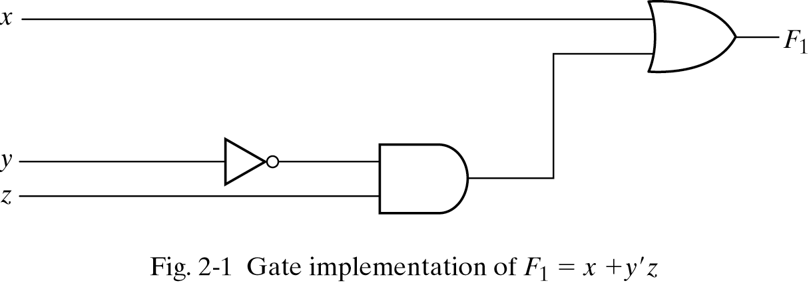
Implementation of Boolean Function Using AND, OR and NOT Gates:

Slide 37
NAND and NOR Implementations
NAND and NOR gates are universal gates.
Using NAND gate we can implement NOT,AND and OR gates.
Similarly using NOR gate we can implement NOT, AND and OR gate.
We want to implement digital circuits using NAND and NOR gates as they are easier to fabricate than AND OR and NOT gates.
Therefore we want to implement Boolean functions using either NAND gates or NOR gates.

Slide 38
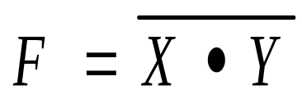
NAND Gate function
NOT-AND function
Input |  | Output
X | Y | F
0 | 0 | 1
0 | 1 | 1
1 | 0 | 1
1 | 1 | 0
38

Slide 39
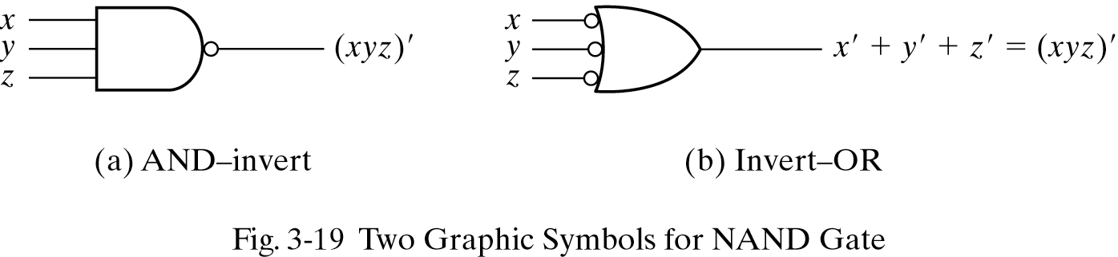
Graphical Representation of NAND Gate:
39

Slide 40
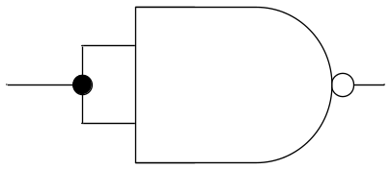
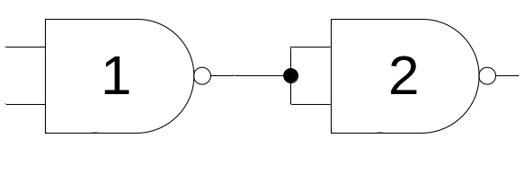
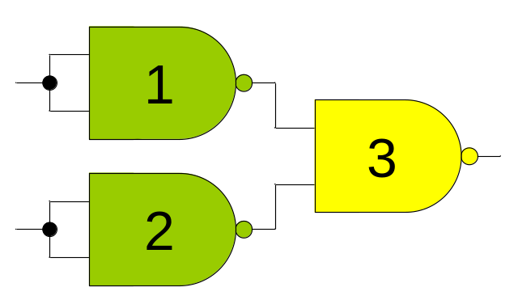
Implementation of NOT, AND and OR Gate Using NAND Gate:
NOT Gate
AND Gate
OR Gate
40

Slide 41
NAND: 2 Level Implementation Procedure:
Simplify the function and express it in standard SOP.
Draw the NAND gate for each product term.
Draw the single gate using AND-invert or invert-OR symbol for sum term.
A term with single literal, complement if needed.
41

Slide 42
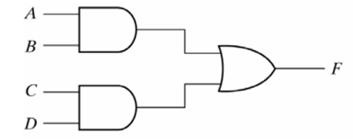
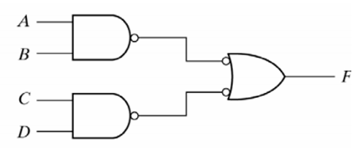
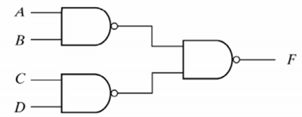
Example:
F= AB +CD
42

Slide 43
Multilevel NAND Circuits
Represent the Boolean function into multilevel AND-OR diagram.
Convert all AND gate to NAND gates.
Convert OR gates to NAND gates with invert-OR symbol.
Balance all bubbles, insert inverter if needed.
43

Slide 44
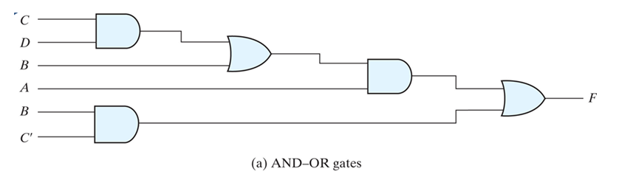
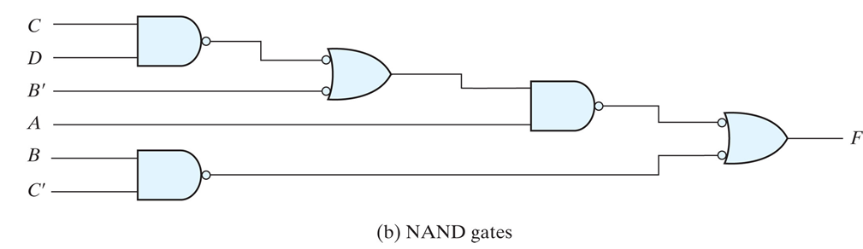
Conversion of Multi-level Logic to NAND Gates
F = A (B + C D) + B C'

Slide 45
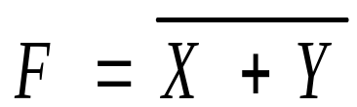
NOR Gate function
OR-NOT function
Input |  | Output
X | Y | F
0 | 0 | 1
0 | 1 | 0
1 | 0 | 0
1 | 1 | 0
45

Slide 46
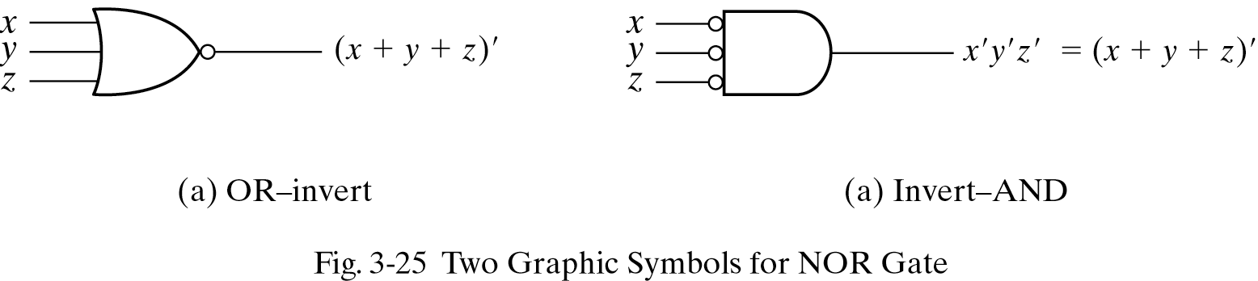
Graphical Representation of NOR Gate:
46

Slide 47
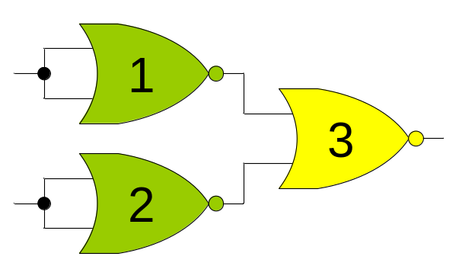
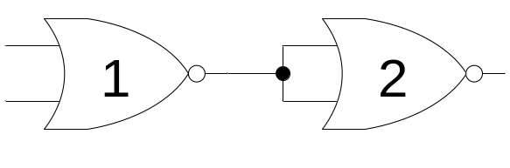
Implementation of NOT, AND and OR Gate Using NOR Gate:
NOT Gate
AND Gate
OR Gate
47

Slide 48
NOR: 2 Level Implementation Procedure:
Simplify the function and express it in POS.
Draw the NOR gate for each sum term.
Draw the single gate using OR-invert or invert-AND symbol for product term.
A term with single literal, complement if needed.
48

Slide 49
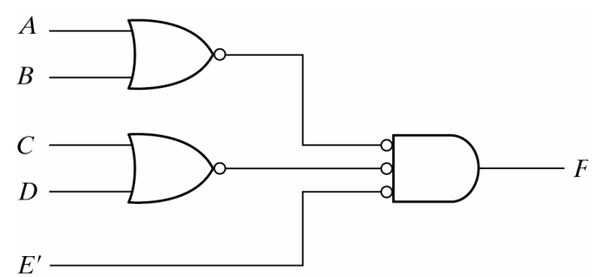
Example:
F= (A+B)(C+D)E
49

Slide 50
Multilevel NOR Circuits
Represent the Boolean function into multilevel AND-OR diagram.
Convert all AND gate to NOR gates with invert AND symbol.
Convert OR gates to NOR gates.
Balance all bubbles, insert inverter if needed.
50

Slide 51
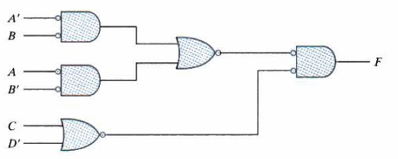
Example
F = (AB’ + A’B)(C + D’)
51

Slide 52
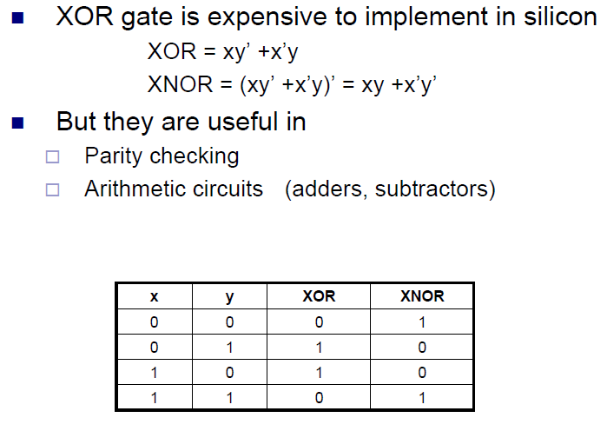

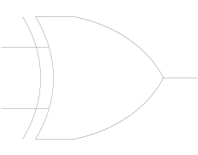
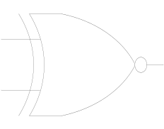
Exclusive-OR (XOR) Function
XOR
XNOR

Slide 53
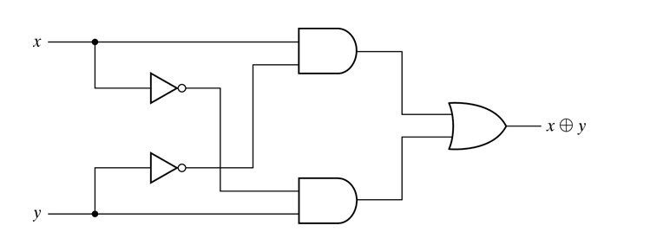
XOR Function
XOR = xy’+x’y

Slide 54


XOR Function Properties
Commutative
Associative

Slide 55

Three Variables XOR/XNOR Function.
x
0
0
0
0
1
1
1
1
y
0
0
1
1
0
0
1
1
z
0
1
0
1
0
1
0
1
F₁
0
1
1
0
1
0
0
1
F₂
1
0
0
1
0
1
1
0
XOR is odd function
XNOR is even function

Slide 56

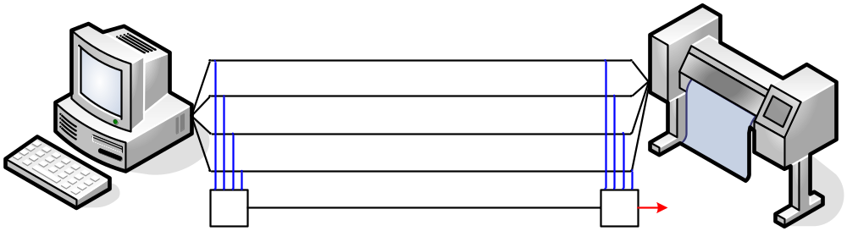
Parity Generation & Checking (Even)
1
0
1
0
1
0
1
0
1
0
0
0
✗
1
0
1
0
0
1
0
1
0
0
1
0
0
0
0
✗
✗
Parity Generator
Parity Checker

Slide 57
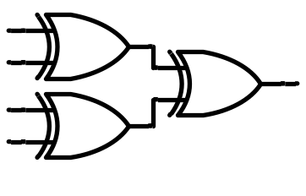
Parity Generation (Even)
1
0
1
0
1
0
1
0
0
Even number of ‘1’s

Slide 58
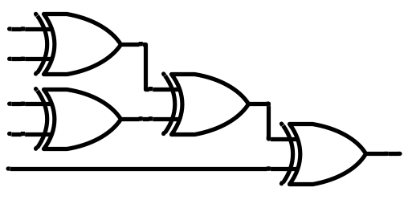
Parity Checking (Even)
1
0
1
0
0
Error
Check

Slide 59
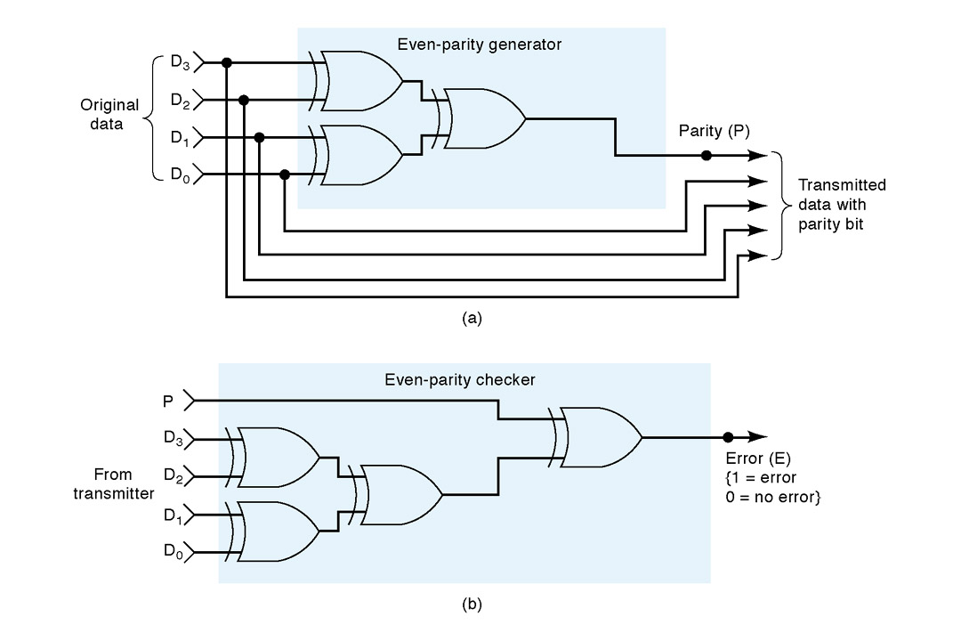
Overall Picture (Even Parity)
Transmitter (TX)
Receiver (RX)

